Slide 1
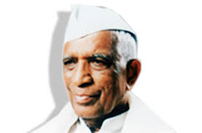
COUNCIL of Education’s Deshbhakta Ratnappa Kumbhar College of Commerce, Kolhapur
Department of BBA
organizes
A Guest Lecture On
Awareness and career opportunities in share market
Speaker – Mr. Shankar Shirulkar
President – Prin. Dr. V.A. Patil
Coordinator
Asst. Prof. Mrs. S.S. Benade

